Slide 1
Data Analysis of Superstore

Slide 2
About Dataset:
This superstore dataset is downloaded from www.Kaggle.com.
This dataset contains 12 columns and 9995 rows.
This shows the sales and profits of different categories of products in different regions & states of the country.
The data contains information about ship mode, segment, country, city, state, postal code, region, category, sub-category, sales, quantity, discount and profit.

Slide 3
Problem statements & the result:
Which is the top category that generates highest amount of sales? From the analysis it is observed that the category Technology generates highest amount of sales and the sub-category phones generates the highest amount of sales.
Which region and state has the highest amount of sale? The west region has the highest amount of sale and the state California has the highest sale.
Mention top 5 cities names and sales ? 1.New York City :62,037 2.Los Angeles: 30,441 3. Seattle: 29,156 4. San Francisco: 17,507 5. Detroit: 13,182.
Which Sub-Category and segment has the highest profit & sales? The segment consumer & subcategory chairs has the highest amount of sales & the segment consumer & sub-category copiers has the highest profit.
Mention 5 states which has the lowest profit in response to discount? 1. Texas: -25,729 2. Ohio: -16,971 3. Pennsylvania: -15,560 4. Illinois: -16,208 5. North Carolina: -7,941

Slide 4
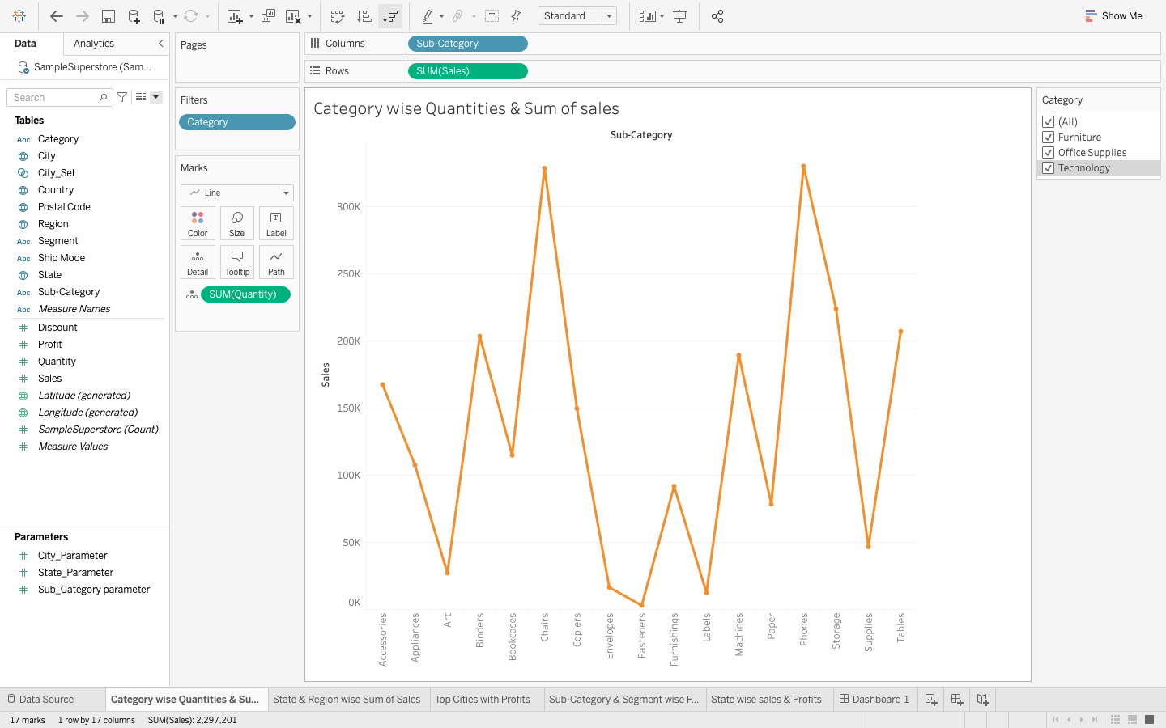

Slide 5
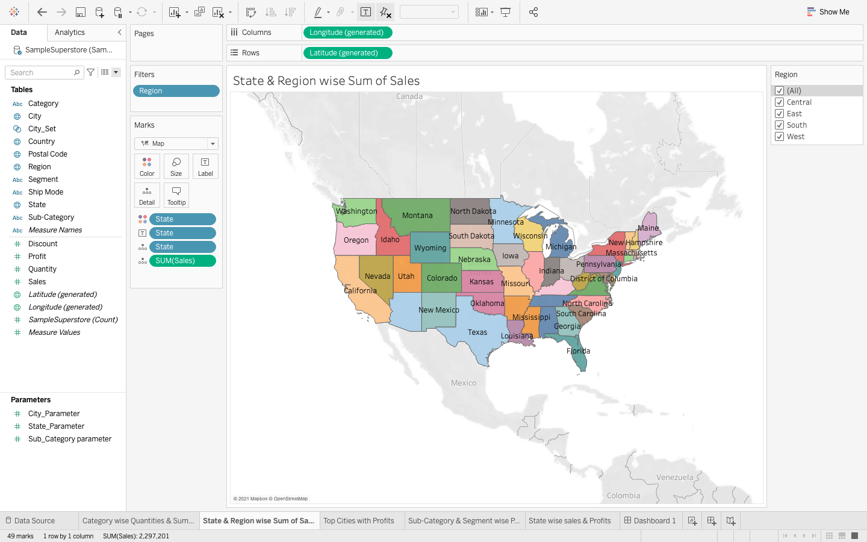

Slide 6
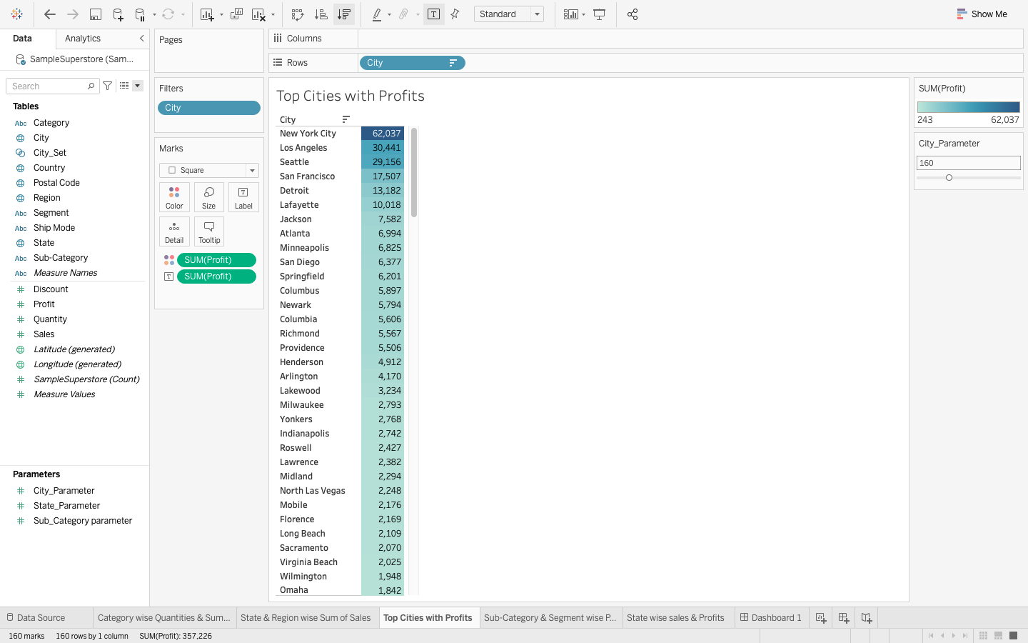

Slide 7
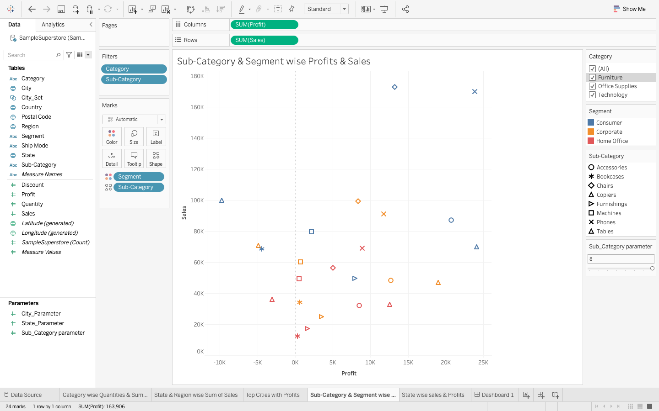


Slide 8

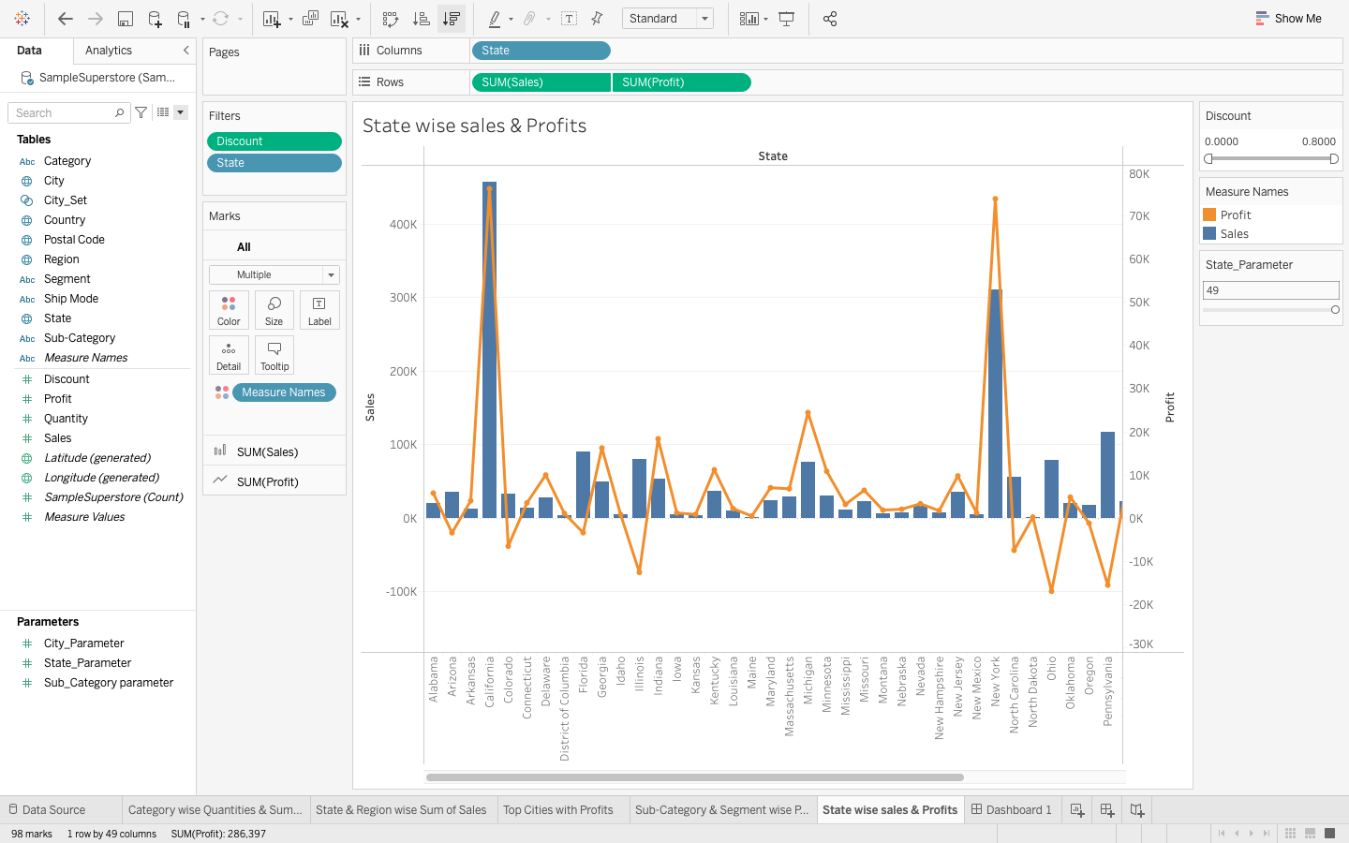

Slide 9
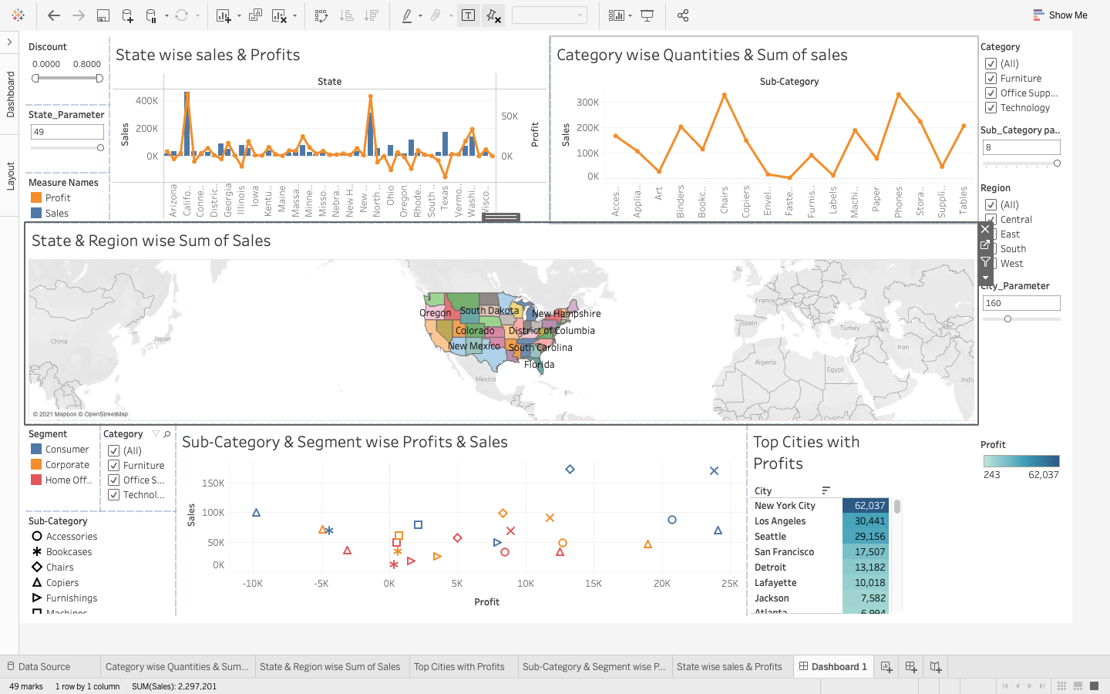

Slide 10
Conclusion:
After thorough analysis the data and the problem statement the superstore is overall doing a good business and produce good profits in almost every sector.
The sales are more in developed regions and expanding in a good pace.
The Superstore will make more profit if –
Try to increase the sales and gain more profits in states like Texas, Ohio, Pennsylvania, Illinois, North Carolina.
Try to increase in profits in category office sales.
Should focus more on corporate & Home Office segment.
Link: https://drive.google.com/file/d/1Sxu4ArfXwclxQtFDYJ9l4tRf2T1nCVyR/view?usp=sharing

